Slide 1
Alerts in the City of Depok: Exploring Data Insights
Rakha Kahansa Putra
Kelompok 6
DSLS 2023 – Mini Project DS

Slide 2
Outline
Background
Data Understanding
EDA & Preprocessing
Modelling & Evaluation
Suggestion & Conclusion

Slide 3
Background

Slide 4
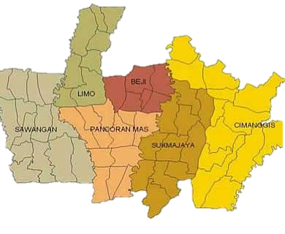
Depok and Why Alerts Important?
Depok City
Why Alerts are Important?
Alerts are notifications sent to stakeholders about events that may impact a city's infrastructure, such as road closures, traffic accidents, or natural disasters.
Alerts are important for managing a city's infrastructure because they enable stakeholders to take timely action to reduce the impact of disruptions on residents, businesses, and transportation systems.
Tracking and analyzing alerts data helps city officials understand the frequency, duration, and causes of disruptions.
Analyzing alerts data can inform strategies to improve a city's infrastructure and reduce the impact of future disruptions.
Essential Information:
Located in West Java but Part of Greater Jakarta Area
The population around 2 million (2021) and covers an area of 200.29 sq km.

Slide 5
Business Understanding
Business Context
Stakeholder
The city of Depok faces infrastructure-related challenges, such as road closures, traffic congestion, and natural disasters, that can impact the daily lives of residents and businesses.
To manage these challenges effectively, city officials need to have access to timely and accurate information about disruptions to the city's infrastructure.
Local government officials in charge of transportation and emergency management.
Transportation providers, such as bus and taxi companies.
City residents and businesses.

Slide 6
Data Understanding

Slide 7
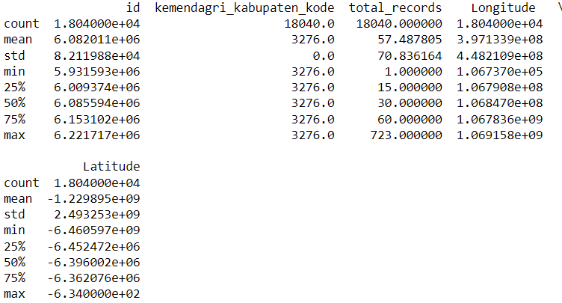
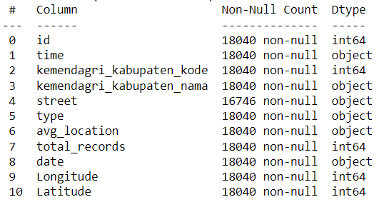
Data Overview
The dataset used in this project generated from Waze for Cities about alerts in Depok.

Slide 8
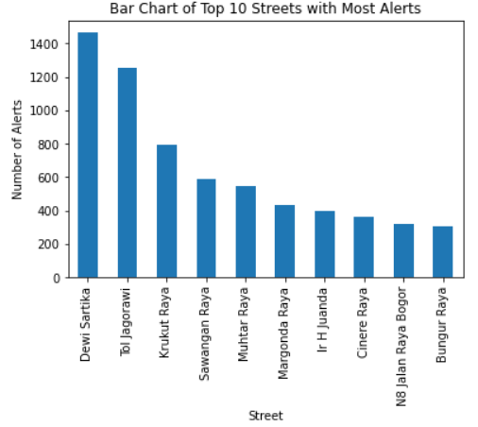
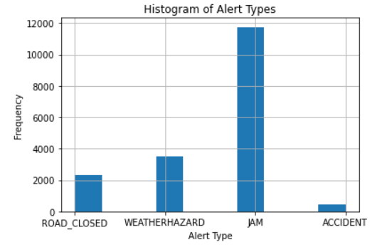
EDA

Slide 9
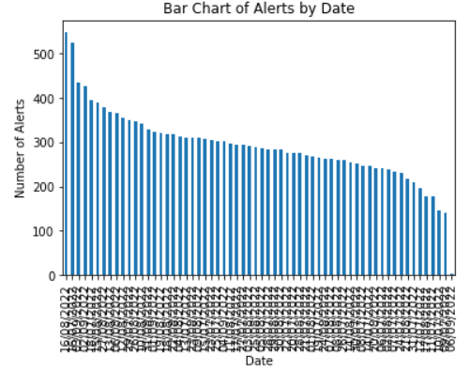
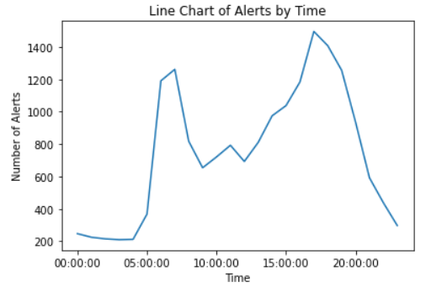
EDA

Slide 10
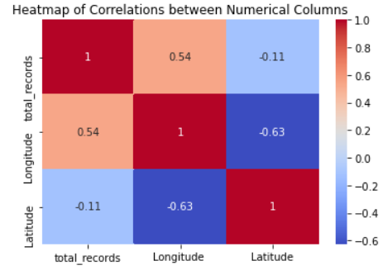
EDA

Slide 11
Modelling & Evaluation

Slide 12
K Means CLustering
Data Preprocessing
Exploratory Data Analysis
K Means Clustering
Hyperparameter Tuning
Re Modelling
Visualisation

Slide 13
K Means Clustering
Extracts the relevant columns 'Latitude' and 'Longitude' from the alerts_data DataFrame and stores them in a new DataFrame called X.
Uses the KMeans algorithm with k=3 to cluster the data points in X.
Assigns each data point in X to one of the five clusters based on the cluster center that is closest to it.
Adds a new column 'cluster' to the alerts_data DataFrame, which contains the cluster label for each data point.
Plots the clusters on a scatter plot, with the x-axis representing longitude and the y-axis representing latitude. Each data point is colored according to its assigned cluster label, with different colors representing different clusters.

Slide 14
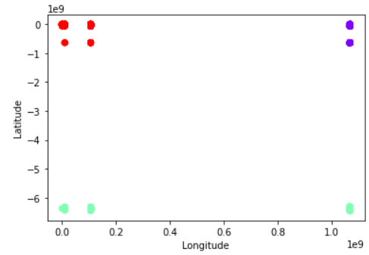
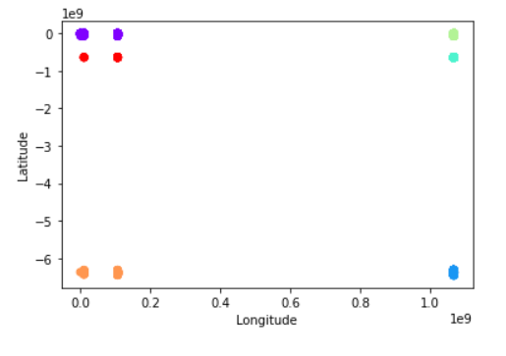
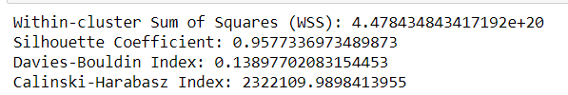

Results
Before Hyperparameter Tuning
(K Cluster = 3)
After Hyperparameter Tuning
(K Cluster = 6)

Slide 15
Evaluation
Silhouette Coefficient: compare the similarity of a data point to its assigned cluster with the similarity to other clusters.
Davies-Bouldin Index: measures the average similarity between each cluster and its most similar cluster
Calinski-Harabasz Index: measures the ratio of the between-cluster variance to the within-cluster variance

Slide 16
Evaluation

Slide 17
Conclusion & Suggestion

Slide 18
Conclusion
Identify areas of high alert frequency:
The K Means Clustering analysis helps to identify areas with a high frequency of alerts. This information can be used to direct more resources towards these areas to improve safety and reduce the number of alerts.
Improve traffic management:
By analyzing the types of alerts in different clusters, stakeholders can gain insights into the types of traffic issues that are most common in different areas. This information can be used to develop targeted solutions to address these issues, such as traffic rerouting, improving traffic light synchronization, or increasing public transportation options.
Enhance emergency response:
In areas where accidents or road closures are more frequent, stakeholders can work to improve emergency response times and increase the availability of emergency services.
Increase public awareness:
The data analysis can be used to develop targeted public awareness campaigns about safe driving, road safety, and the importance of following traffic rules.

Slide 19
Suggestion
Increase road infrastructure development in Jagorawi and Muhtar and Sawangan Areas, as they have the highest frequency of accidents and traffic jams.
Improve weather hazard detection systems in Tol Jagorawi & Karanggan areas, which experience the highest frequency of weather-related hazards.
Accelerate on going projects and development in Dewi Sartika area, which has the highest occurrence of road closed in that period.
Increase marketing and development efforts where there are fewer incidents and hence a lower sense of urgency among the population.

